Slide 1
Introduction to Natural Language Processing
Week 11, Day 1

Slide 2
What is Natural Language Processing (NLP)
Natural Language Processing, NLP refers to a field in computer science that deals with the interaction between computer and human languages. NLP aims at allowing computers to interpret human linguistics at various levels.
In the other word, Natural language processing is about automating the analysis, generation and acquisition of human (natural) language
1-In terms of analysis, input is language and output is representation that support useful actions. For example when we talk to a voice assistant
2-The opposite of analysis, is generation. In generation, the input is the representation and the output is language
3-Acquisition is obtaining representation from knowledge or data.

Slide 3
Why is NLP difficult
1-Ambiguity: A natural language has a rich form and structure which introduces an ambiguity in text are. Ambiguity refers to different meanings for the same content. Some examples of ambiguity are as follow:
“dog ate a bone” and “bone dog a ate”. Here both sentences have the same words with the same frequency. However, the position of word occurrence provides meaning to the first sentence and not to the other.
“Jack saw Ben with a telescope on a mountain”: In the given sentence, is it Jack with a telescope or Ben? Similarly, who is on the mountain?
“I went to the bank”: The word bank may refer to a financial bank as well as a riverbank.
2- Corpora: Another major challenge for NLP for other languages is the lack of required corpus. Deep Learning based NLP solutions highly rely on data and it’s quality provided during training. However, models trained on a limited amount of data do not provide great results. As a result, building NLP models for non-English is a cumbersome task and has a large scope of future work.

Slide 4
Classification of Natural Language Processing
Natural Language Processing is broadly classified into the following:
1-Natural language understanding: NLU deals with understanding a given text and interpreting its meaning. It converts human language into a structured format that is usable by a computer.
2-Natural language generation: NLG deals with generating a Natural Language from the available amount of textual data. It involves making sentences that are understood by a human.
Stages of NLP
Lexical Analysis, Syntax Analysis, Semantic Analysis, Discourse, Pragmatics

Slide 5
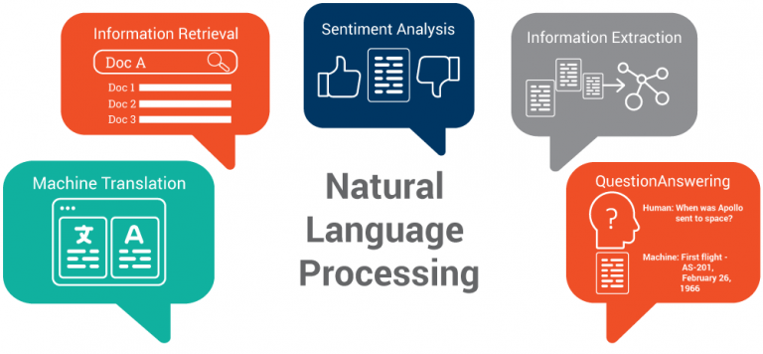
NLP Application

Slide 6
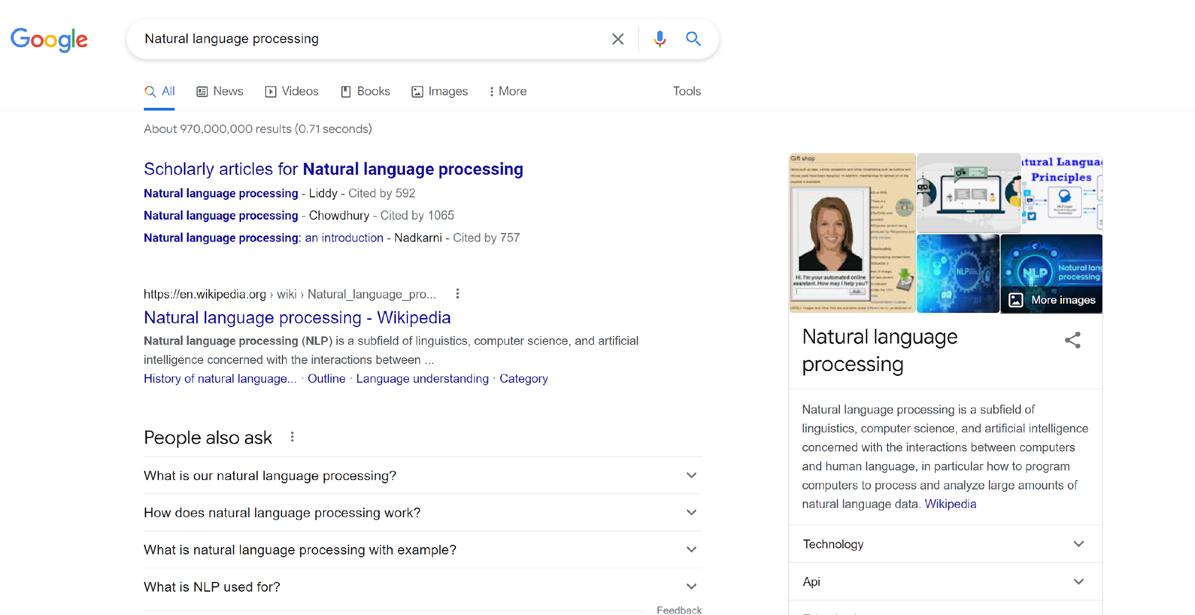
NLP Application: Information Retrieval
Information retrieval is defined as the process of accessing and retrieving the most appropriate information from text based on a particular query given by the user, with the help of context-based indexing or metadata.
Google Search is the most famous example of information retrieval.
An information retrieval system searches a collection of natural language documents with the goal of retrieving exactly the set of documents that matches a user’s question. They have their origin in library systems.

Slide 7
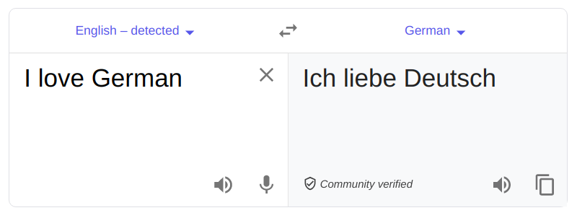
NLP Application: Machine Translation
Machine Translation is the procedure of automatically converting the text in one language to another language while keeping the meaning intact.
In earlier days, machine translation systems were dictionary-based and rule-based systems, and they saw very limited success. However, due to evolution in the field of Deep Learning and NLP, availability of humongous data, and powerful machines, machine translation has become fairly accurate in converting the text from one language to another.

Slide 8
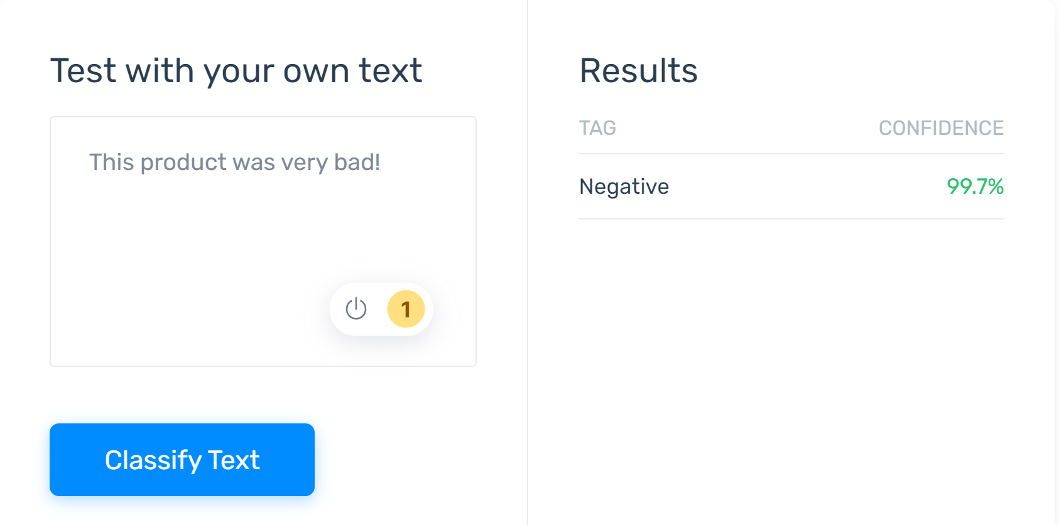
NLP Application: Sentiment Analysis
Natural language understanding is particularly difficult for machines when it comes to opinions, given that humans often use sarcasm and irony. Sentiment analysis, however, is able to recognize subtle nuances in emotions and opinions ‒ and determine how positive or negative they are.
You can try this service from here: Semantic Analysis

Slide 9
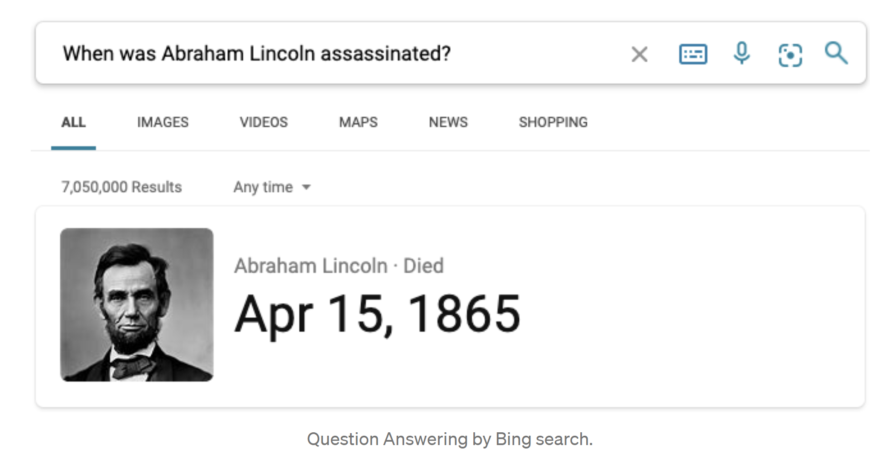
NLP Application: Question Answering
Question Answering(QA) system is a system that gives appropriate answers to questions expressed in natural languages such as English, Chinese, and so on. For example, suppose a user asks “When was Abraham Lincoln assassinated?” In this case, the question answering system is expected to return “Apr 15, 1865”.
A question answering system will help you find information efficiently. Generally speaking, we use search engines to search for relevant documents when we look for some information on the Web. However, because they show you documents, you must read the documents and decide whether they contain the information you need. It’s a bother. Thus, commercial search engines have a question answering feature so that you can find information efficiently.

Slide 10
Data Preprocessing
Data preprocessing is an essential step in building a Machine Learning model and depending on how well the data has been preprocessed; the results are seen. In NLP, text preprocessing is the first step in the process of building a model. The various text preprocessing steps are: Tokenization, stimming, removing stopwords.

Slide 11
Data Preprocessing
Task 1: Load the dataset
Task 2: Lowercase the data
Task 3: Remove digits from data
Task 4: Remove Punctuation
Task 5: Removing trailing whitespaces
Task 6: Tokenize the text and removing stop words
Task 7: Stemming
Task 8: Lemmatization

Slide 12
Task 1: Loading Text Data
To make it simple, for the first sample we use a simple text to explain the concept then in the next step we will download some common text datasets.
#This will be our corpus which we will work on
corpus_original = "Need to finalize the demo corpus which will be used for this notebook and it should be done soon !!. It should be done by the ending of this month. But will it? This notebook has been run 4 times !!"
corpus = "Need to finalize the demo corpus which will be used for this notebook & should be done soon !!. It should be done by the ending of this month. But will it? This notebook has been run 4 times !!"

Slide 13
Task 2: Lowercase the text
In some NLP applications, we need to lowercase the text for the better processing:
Output:
#lower case the corpus
corpus = corpus.lower()
print(corpus)
need to finalize the demo corpus which will be used for this notebook & should be done soon !!. it should be done by the ending of this month. but will it? this notebook has been run 4 times !!

Slide 14
Task 3: Remove digits from data
Sometimes in text processing, we don’t need the digits in the text. Using the code bellow, digits can be removed from the text.
Output:
#removing digits in the corpus
import re
corpus = re.sub(r'\d+','', corpus)
print(corpus)
need to finalize the demo corpus which will be used for this notebook & should be done soon !!. it should be done by the ending of this month. but will it? this notebook has been run times !!

Slide 15
Task 4: Remove Punctuation
It is better to handle special characters in text preprocessing step that will helps the model to improve the performance.
Output:
#removing punctuations
import string
corpus = corpus.translate(str.maketrans('', '', string.punctuation))
print(corpus)
need to finalize the demo corpus which will be used for this notebook should be done soon it should be done by the ending of this month but will it this notebook has been run times

Slide 16
Task 5: Removing trailing whitespaces
To clean up the text we remove the trailing whitespaces of the text. Using the following code we can easily remove whitespaces.
Output
#removing trailing whitespaces
corpus = ' '.join([token for token in corpus.split()])
corpus
need to finalize the demo corpus which will be used for this notebook should be done soon it should be done by the ending of this month but will it this notebook has been run times

Slide 17
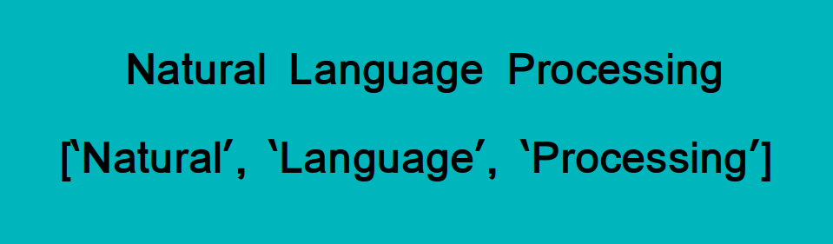
Task 6:Tokenize the text and remove stop words
Tokenization is essentially splitting a phrase, sentence, paragraph, or an entire text document into smaller units, such as individual words or terms. Each of these smaller units are called tokens.
Check out this image to visualize this definition:
The tokens could be words, numbers or punctuation marks. In tokenization, smaller units are created by locating word boundaries. What are word boundaries?
These are the ending point of a word and the beginning of the next word. These tokens are considered as a first step for stemming and lemmatization.
Stop words refers to words like "and, is, a, on, etc."

Slide 18
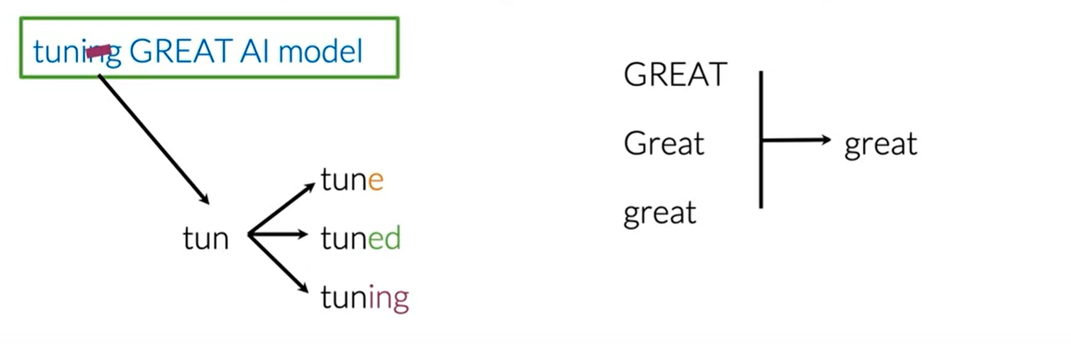
Task 6: Stemming
Stemming in NLP is simply transforming any word to its base stem, which you could define as the set of characters that are used to construct the word and its derivatives. Let's take the first word from the example.
Look at the below image. After you perform stemming on your corpus, the word tune, tuned, and tuning will be reduced to the stem tun.

Slide 19
Task 7: Stemming
Output:
from nltk.stem import PorterStemmer
from nltk.tokenize import word_tokenize
stemmer= PorterStemmer()
print("Before Stemming:")
print(corpus)
print("After Stemming:")
for word in tokenized_corpus_nltk:
print(stemmer.stem(word),end=" ")
need to finalize the demo corpus which will be used for this notebook should be done soon it should be done by the ending of this month but will it this notebook has been run times

Slide 20
Task 8: Lemmatization
Stemming just removes or stems the last few characters of a word, often leading to incorrect meanings and spelling. Lemmatization considers the context and converts the word to its meaningful base form, which is called Lemma.
Output:
from nltk.stem import WordNetLemmatizer
from nltk.tokenize import word_tokenize
nltk.download('wordnet')
lemmatizer=WordNetLemmatizer()
for word in tokenized_corpus_nltk:
print(lemmatizer.lemmatize(word),end=" ")
need to finalize the demo corpus which will be used for this notebook should be done soon it should be done by the ending of this month but will it this notebook has been run time

Slide 21
Bag of Word
After tokenization we have a bag of words that can be used for classification purpose.
NLTK Tokenized corpus: ['need', 'to', 'finalize', 'the', 'demo', 'corpus', 'which', 'will', 'be', 'used', 'for', 'this', 'notebook', 'should', 'be', 'done', 'soon', 'it', 'should', 'be', 'done', 'by', 'the', 'ending', 'of', 'this', 'month', 'but', 'will', 'it', 'this', 'notebook', 'has', 'been', 'run', 'times'] Tokenized corpus without stopwords: ['need', 'finalize', 'demo', 'corpus', 'used', 'notebook', 'done', 'soon', 'done', 'ending', 'month', 'notebook', 'run', 'times']

Slide 22
Limitations of Bag-of-Words
Although Bag-of-Words is quite efficient and easy to implement, still there are some disadvantages to this technique which are given below:
1- The model ignores the location information of the word. The location information is a piece of very important information in the text. For example “today is off” and “Is today off”, have the exact same vector representation in the BoW model.
2- Bag of word models doesn’t respect the semantics of the word. For example, words ‘soccer’ and ‘football’ are often used in the same context. However, the vectors corresponding to these words are quite different in the bag of words model.
3- The range of vocabulary is a big issue faced by the Bag-of-Words model. For example, if the model comes across a new word it has not seen yet, rather we say a rare, but informative word like Biblioklept(means one who steals books). The BoW model will probably end up ignoring this word as this word has not been seen by the model yet.
Source: https://www.mygreatlearning.com/blog/bag-of-words/

Slide 23
References
https://nlp.stanford.edu/
https://www.mygreatlearning.com/blog/bag-of-words/
https://monkeylearn.com/sentiment-analysis-online/

